Slide 1
Application Layer I
Chapter 3
CCNA Exploration 1

Slide 2
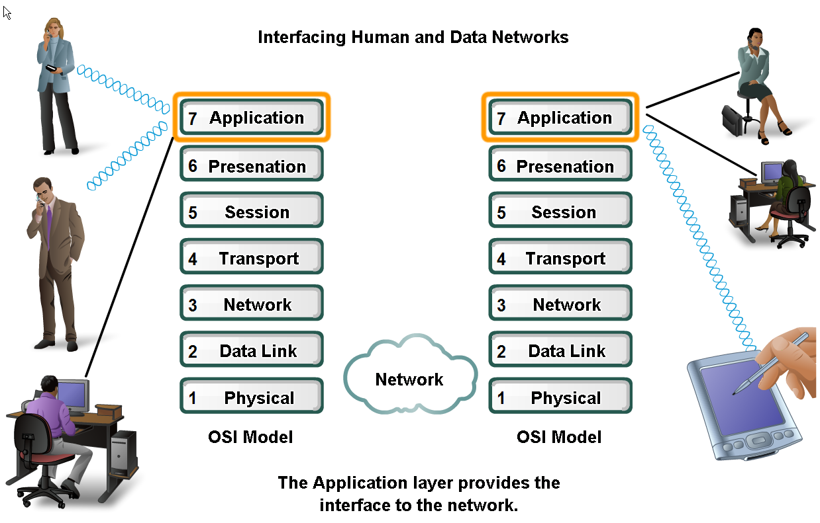
Applications
The Interface Between Human and Data Networks
Notes:
It provides the interface between the applications we use to communicate and the underlying network over which our messages are transmitted.

Slide 3
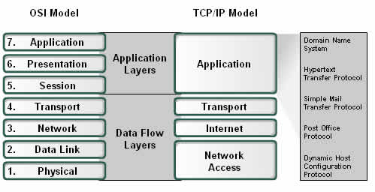
Application Layer
Notes:
Application layer protocols are used to exchange data between programs running on the source and destination hosts.
There are many Application layer protocols and new protocols are always being developed

Slide 4
Application Layer Protocols
Application layer is the top most layer of TCP/IP model.
Application layer is present on the top of the Transport layer.
Application layer defines TCP/IP application protocols and how host programs interface with Transport layer services to use the network.
Application layer includes all the higher-level protocols like:
  DNS (Domain Name System),
  HTTP (Hypertext Transfer Protocol),
  Telnet, SSH(Secure Shell)
  FTP (File Transfer Protocol),
  TFTP (Trivial File Transfer Protocol),
  SNMP (Simple Network Management Protocol),
  SMTP (Simple Mail Transfer Protocol) ,
  DHCP (Dynamic Host Configuration Protocol)
  And so on
Notes:
Application layer protocols are used to exchange data between programs running on the source and destination hosts.
There are many Application layer protocols and new protocols are always being developed

Slide 5
Application Layer – OSI and TCP/IP Models
Two important concepts:
  Application Layer Protocols:
    Provide the rules and formats that govern how data is treated in the application layer.
  Application Software
    The programs used to communicate over the network.
For example:
  When displaying a web page:
    The Application Layer uses the HTTP Protocol.
    The Application Software is your browser.

Slide 6
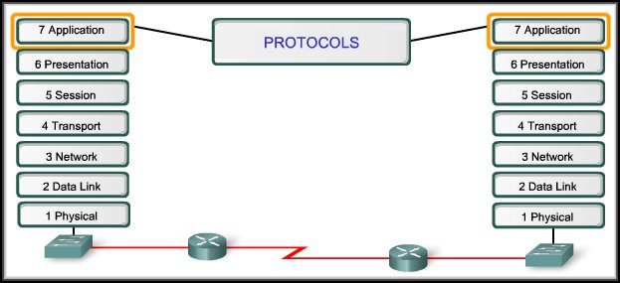
Application Layer Software
Application layer protocols are used by both the source and destination devices during a communication session.
The application layer protocols implemented on the source and destination host must match.

Slide 7
Application Layer Protocols
Establish consistent rules for data exchange.
Specify data structure in the message and types of messages.
Define message dialogues (appropriate responses).

Slide 8
Application Layer Software
IP Header | TCP Header | HTTP Header | Data
Applications and services can use multiple protocols.
For example, using a web browser may invoke:
    DNS, ARP(Address Resolution Protocol), ICMP(Internet Control Message Protocol)
    May use TCP, UDP, Ethernet, PPP (Much More Later)
    Definitely uses IP

Slide 9
Application Layer
Making Provisions for
Applications and Services

Slide 10
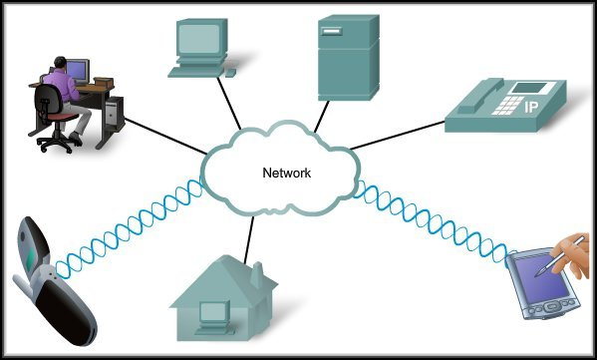
Introduction
When accessing
information on a device,
the data may not be
physically stored on
that device.
If that is the case, a
request must be made
to the device where the
data resides.
Two methods:
  Client/Server
  Peer-to-Peer (P2P)

Slide 11
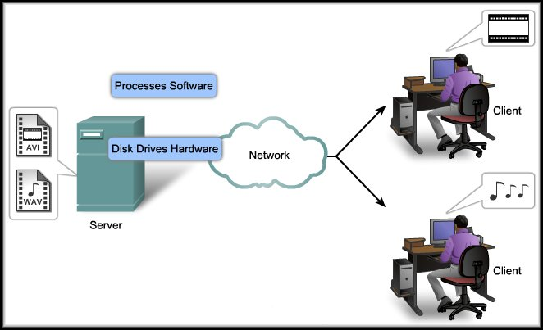
Servers
Servers are
repositories of
information.
Processes on
the server
control the
delivery of
information
to the client.
The information is usually shared with multiple clients.
  Web Server
  Email Server

Slide 12
Servers
Some servers
may require
user
authentication
to access the
data or the
network.
FTP Server:
May require
an account and password before allowing a transfer.

Slide 13
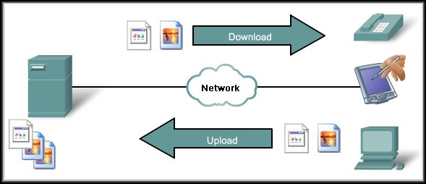
Client/Server Model
May also require control information.
User Authentication
or identify a file to be transferred.
Clients – hardware, software combination
Files downloaded
to the client.
The client begins the exchange by making a request for data.
The server responds with one or more streams of data.
Files uploaded to the server
Resources are stored on the server.

Slide 14
Client/Server Model
The biggest advantage of the client/server model
is the centralization of resources.
User Names and Passwords, Files, Databases.

Slide 15
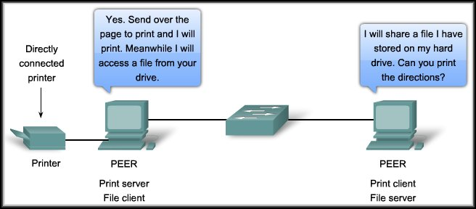
Peer-to-Peer Model: P2P Networking
Two or more computers are connected via a network and can share resources (such as printers and files) without having a dedicated server.
End devices (peers) can function as either a server or client depending upon the required service.
Notes:
Every connected end device (known as a peer) can function as either a server or a client.
Peer-to-peer networks decentralize the resources on a network without using a centralized server.
One computer might assume the role of server for one transaction while simultaneously serving as a client for another. The roles of client and server are set on a per request basis.

Slide 16
Peer-to-Peer (P2P) Networking
One big disadvantage of P2P networking is that it decentralizes the services on a multiuser network.
Maintaining security and access policies on a P2P network is definitely a challenge.
All Policies and User Names and Passwords must be maintained on each peer device.

Slide 17
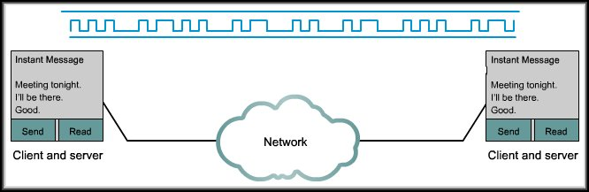
Peer-to-Peer (P2P) Applications
A peer-to-peer application, unlike a peer-to-peer network, allows a device to act as both a client and a server within the same communication.
Notes:
Both can initiate a communication and are considered equal in the communication process.
In other words, in this model, every client is a server and every server a client.
peer-to-peer applications require that each end device provide a user interface and run a background service. When you launch a specific peer-to-peer application it invokes the required user interface and background services. After that the devices can communicate directly.
Some P2P applications use a hybrid system where resource sharing is decentralized but the indexes that point to resource locations are stored in a centralized directory. In a hybrid system, each peer accesses an index server to get the location of a resource stored on another peer. The index server can also help connect two peers, but once connected, the communication takes place between the two peers without additional communication to the index server.
Peer-to-peer applications can be used on peer-to-peer networks, client/server networks, and across the Internet.

Slide 18
Application Layer
Application Layer Protocols
and Services Examples

Slide 19
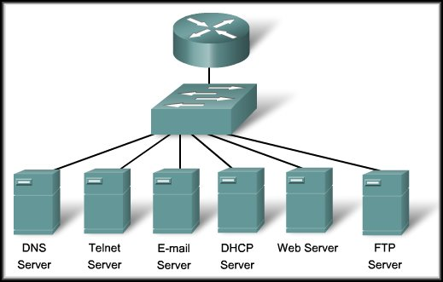
Applications
APPLICATIONS
Usually, a single server will function as a server for multiple application protocols.

Slide 20

DNS
Domain Name System
Helping Protocol

Slide 21
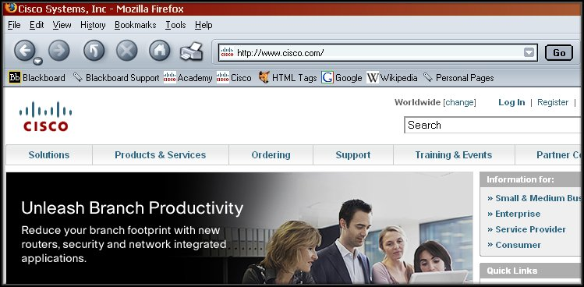
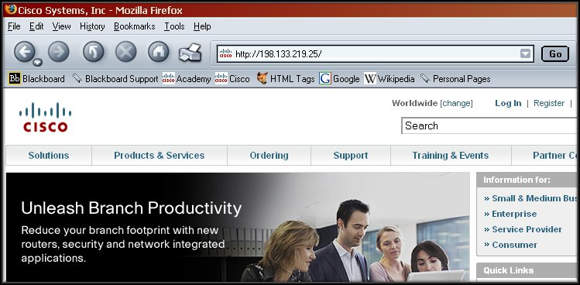
Domain Name System (DNS)
DNS allows us to use simple, recognizable names instead of an IP Address.

Slide 22
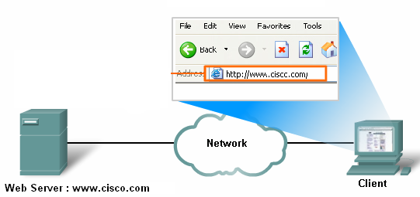
Domain Name System (DNS)
 |  |  |  |  |  | Data: Request for web page | Trailer
?
192.168.1.1
80
1025
Web Browser application Port Number: 1025
www.cisco.com : ? IP address
Web Server application Port Number: 80
IP address : 200.20.20.1
IP address : 192.168.1.1

Slide 23


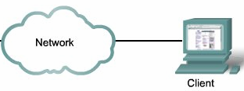
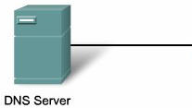
Domain Name System (DNS)
= ? IP address
= ? Unique Numbered Address
Web Server : www.cisco.com
Request
for IP address
Reply:
www.cisco.com =
198.133.219.25
Packet ready
to be send
to www.cisco.com
DNS Address Book:
www.cisco.com = 198.133.219.25
www.yahoo.com = 200.133.2.56
Notes:
DNS and the Browser:
First, a domain name or URL is entered in the address field of the browser. The browser passes the name to the resolver.

Slide 24
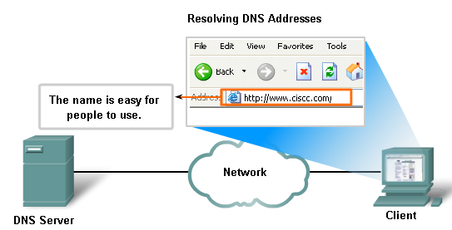
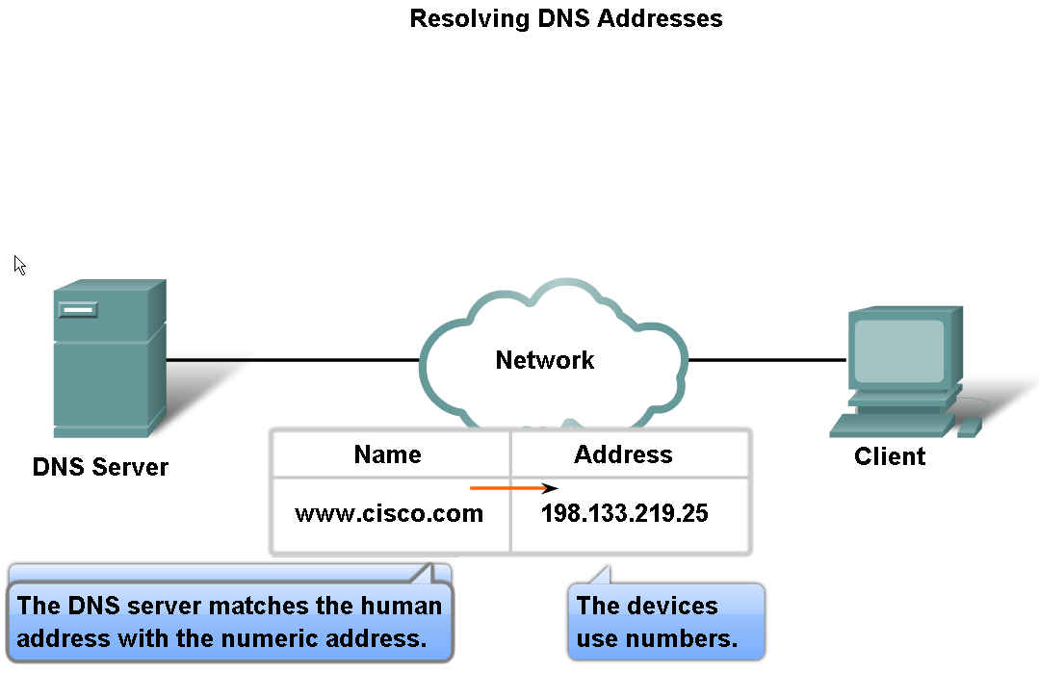
DNS-Domain Name System
Notes:
While other services use a client that is an application (such as web browser, e-mail client), the DNS client runs as a service itself. The DNS client, sometimes called the DNS resolver, supports name resolution for our other network applications and other services that need it.
Users generally do not communicate directly with a DNS resolver. Instead DNS resolution takes place transparently in applications programs such as web browsers, e-mail clients, and other Internet applications. When an application makes a request that requires a domain name lookup, such programs send a resolution request to the DNS resolver in the local operating system, which in turn handles the communications required.

Slide 25
Domain Name System (DNS)
DNS is an automated client/server service.
Internet programs requiring domain name look up send a resolution request to the DNS resolver (Client side of DNS) in the local operating system
The resolver in turn handles the communications required.
Web Browser
DNS
Resolver
Mail Client
Operating System

Slide 26
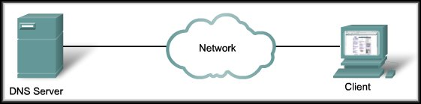
Domain Name System (DNS)
1
DNS and the Browser:
  First, a domain name or URL is entered in the address field of the browser. The browser passes the name to the resolver.

Slide 27
Domain Name System (DNS)
1
2
www.cisco.com
DNS Sever:
Port No. 53
DNS Resolver:
Port No. 1026
IP Address :10.10.1.3
? ? ?
IP Address :10.10.1.2
DNS and the Browser:
  The resolver sends the DNS request to the DNS Server.
 |  |  |  |  |  | Data: Request for Domain Name Lookup | Trailer
MAC of DNS Sever
10.10.1.2
MAC of Client
10.10.1.3
53
1026
MAC Address
IP Address
Port Numbers

Slide 28
Domain Name System (DNS)
How does the resolver know where to send the requests?
  From the IP configuration on the device.
      IP Address 192.168.25.25
      Subnet Mask 255.255.255.0
      Default Gateway 192.168.25.1
      DNS Server 208.67.222.222

Slide 29
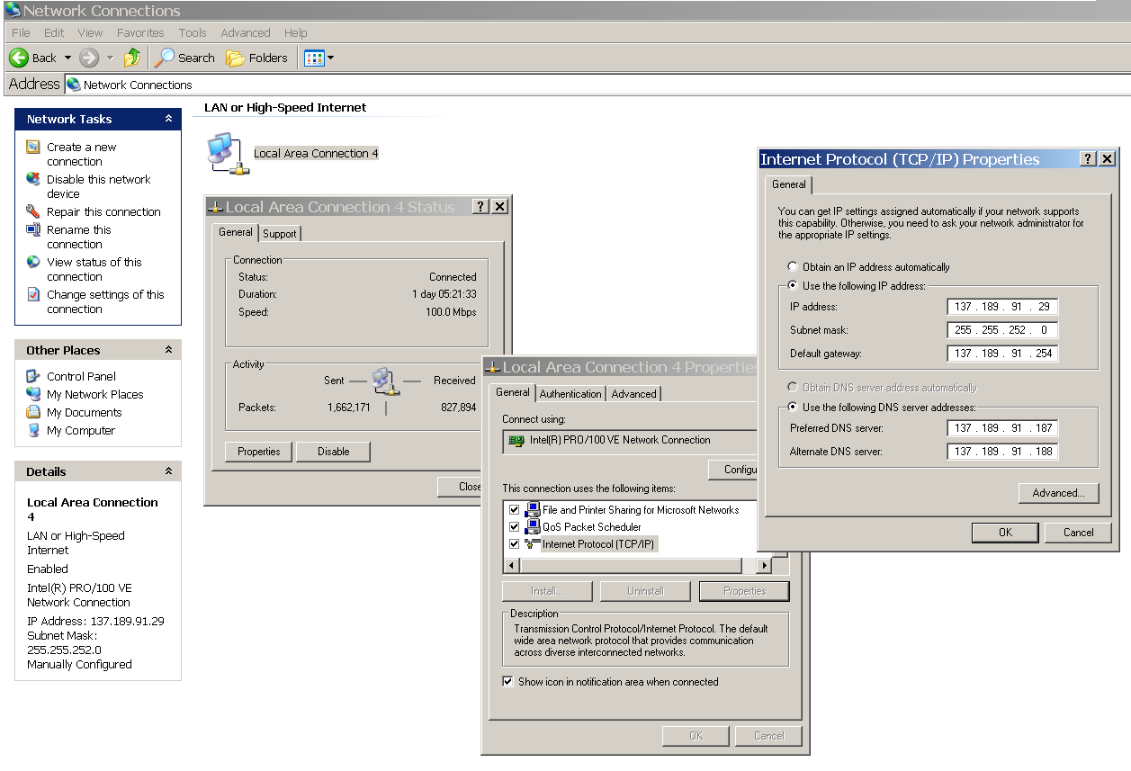
DNS: Client Settings

Slide 30
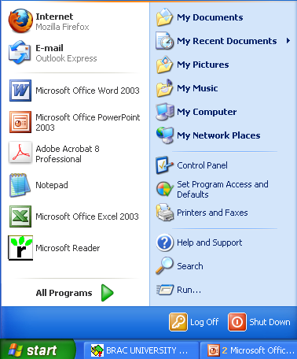
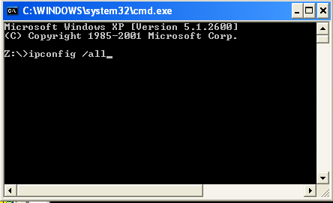
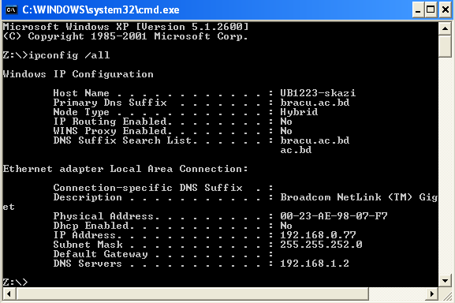
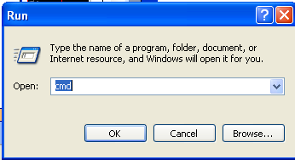
DNS: Client Settings

Slide 31
Domain Name System (DNS)
What about the MAC address of DNS of the server?
How does the resolver know the MAC Address of the DNS Server?
 |  |  |  |  |  | Data: Request for Domain Name Lookup | Trailer
MAC of DNS Sever
10.10.1.2
MAC of Client
10.10.1.3
53
1026
MAC Address
IP Address
Port Numbers

Slide 32
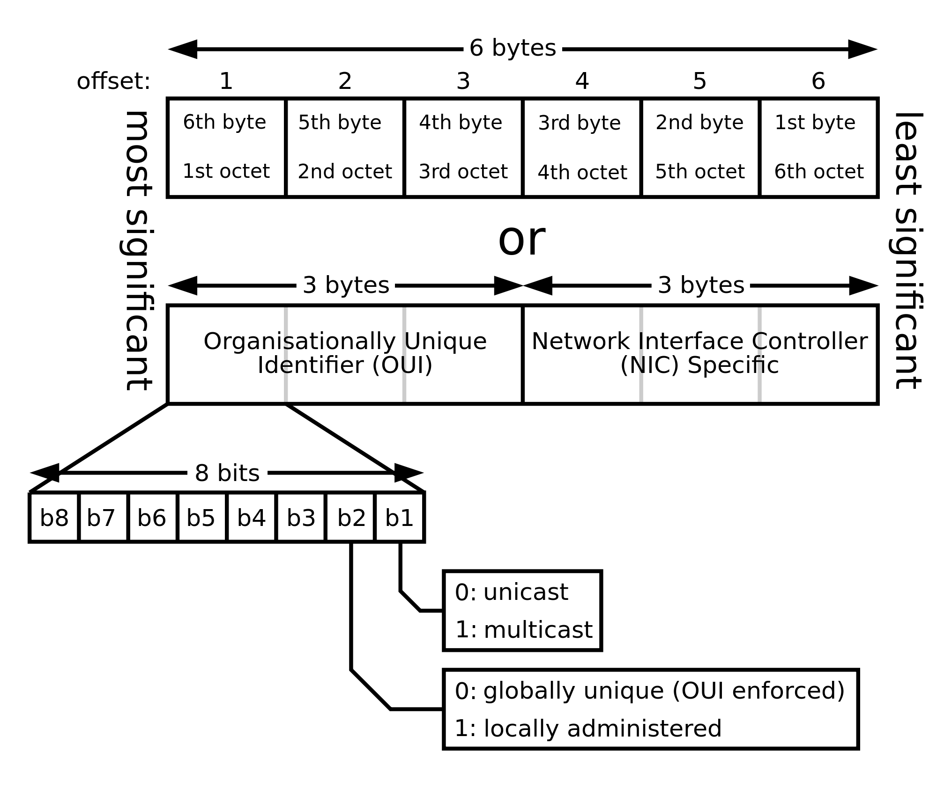
Domain Name System (DNS)
MAC address
Media Access Control address (MAC address)
Also called physical address- is a unique identifier assigned to network interfaces for communications on the physical network segment.
MAC addresses are used as a network address for most IEEE 802 network technologies, including Ethernet and WiFi.
Logically, MAC addresses are used in the media access control protocol sublayer of the OSI reference model.

Slide 33
Domain Name System (DNS)
ARP Reply
ARP Request
DNS Request
ready
to be send.
By the help of ARP (Address Resolution Protocol)
Resolves Known IP address = Unknown MAC Address.
Where to send the ARP request?
  To All Devices in the Network - BROADCAST

Slide 34

Domain Name System (DNS)
DNS Request
10.10.1.3
EE56-F48E-232D-C98A
ARP
Request
ARP
Request
ARP
Request
ARP
Request
ARP
Request
Send it to all =
BROADCAST
Local
ARP
Reply
10.10.1.2
CA38-F358-95D2-E487
MAC BROADCAST ADDRESS
FFFF-FFFF-FFFF-FFFF
FFFF-FFFF-FFFF-FFFF
CA38-F358-95D2-E487
Data: ARP Request
10.10.1.3
10.10.1.2
 |  |  |  |  |  |  | Trailer
MAC of DNS Sever
Data: Request for Domain Name Lookup
EE56-F48E-232D-C98A
???
10.10.1.3
CA38-F358-95D2-E487
53
1026
10.10.1.2
Notes:
DNS and the Browser:
First, a domain name or URL is entered in the address field of the browser. The browser passes the name to the resolver.

Slide 35
Domain Name System (DNS)
1
2
www.cisco.com
3
www.cisco.com = 198.133.219.25
DNS and the Browser:
  The resolver sends the DNS request to the DNS Server.
  The server then searches its records and resolves the name with to a corresponding IP Address.

Slide 36
Domain Name System (DNS)
1
2
www.cisco.com
3
4
www.cisco.com = 198.133.219.25
198.133.219.25
DNS and the Browser:
  The DNS server then sends the IP Address back to the client that made the request. The IP Address will be used in the encapsulation process as the destination address for packets going to www.cisco.com.

Slide 37
DNS Name Servers
Centralized DNS?
Single point of failure
Traffic volume
Distance centralized database
Maintenance
Doesn’t scale!
Solution: Distributed Database
NO
REASONS ?

Slide 38
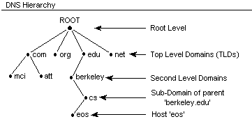
DNS Heirarchy
Also Known as
Authoritative DNS Servers
Local DNS Servers

Slide 39

DNS: Root name servers
13 root name servers worldwide
Contacted by local name server that can not resolve name.
a NSI Herndon, VA
c PSInet Herndon, VA
d U Maryland College Park, MD
g DISA Vienna, VA
h ARL Aberdeen, MD
j NSI (TBD) Herndon, VA
k RIPE London
i NORDUnet Stockholm
m WIDE Tokyo
e NASA Mt View, CA
f Internet Software C. Palo Alto, CA
b USC-ISI Marina del Rey, CA
l ICANN Marina del Rey, CA
Notes:
root name server:
contacts authoritative name server if name mapping not known
gets mapping
returns mapping to local name server

Slide 40
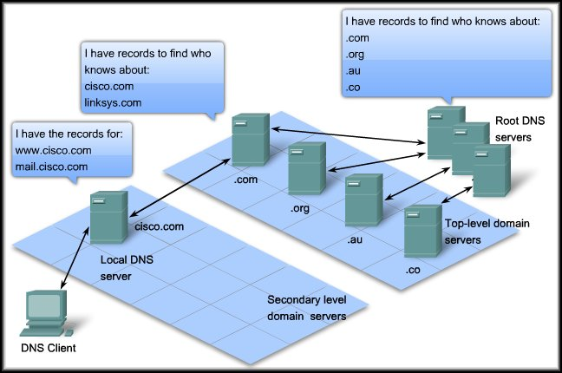
Domain Name System (DNS)
For access to the Internet, DNS servers are arranged in a hierarchy.
References to the hierarchy are included when a local DNS server is installed.

Slide 41
Domain Name System (DNS)
The servers at the “Root” know how to reach the “Top-level” domain servers.
The top-level servers know how to reach the secondary level servers and so on…..

Slide 42
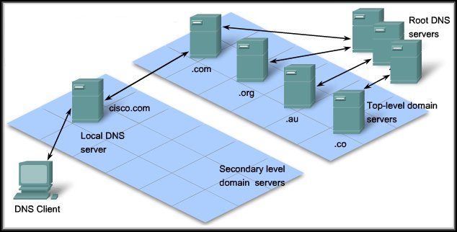
Domain Name System (DNS)
www.site.com = 202.2.2.2
Store in cache, Send to client
www.site.com = 202.2.2.2
? www.site.com
? www.site.com
www.site.com = 202.2.2.2 ….Store in cache
DNS Cache : Storing DNS Information in Local memory
Notes:
When a client makes a query, the server's "named" process first looks at its own records to see if it can resolve the name. If it is unable to resolve, it contacts other servers in order to resolve the name
Once a match is found and returned to the original requesting server, the server temporarily stores the numbered address that matches the name in cache.
If that same name is requested again, the first server can return the address by using the value stored in its name cache. Caching reduces both the DNS query data network traffic and the workloads of servers higher up the hierarchy.

Slide 43
nslookup
Windows operating systems provide the nslookup utility.
Use to query a domain name and get the IP Address.
Can also be used to troubleshoot DNS resolution issues.

Slide 44
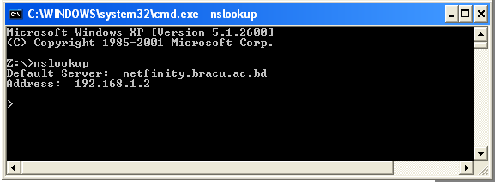
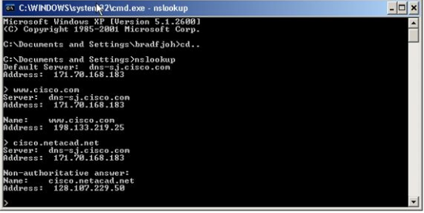
nslookup

Slide 45
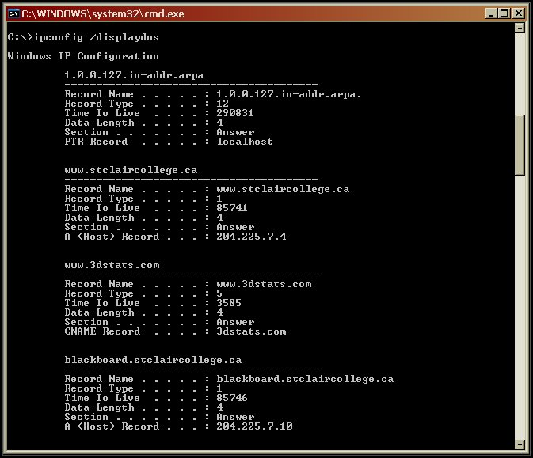
Domain Name System (DNS)
Utility:
ipconfig /displaydns
Displays the contents of the PC cache.
ipconfig /flushdns
Clears the contents of the PC cache.

Slide 46
HTTP
Hypertext Transfer Protocol
And WWW Services

Slide 47



HTTP Components
Client
  Web browser
Server
  Web Server
Protocol
  HTTP, HTTPS
Content
  Web Documents

Slide 48
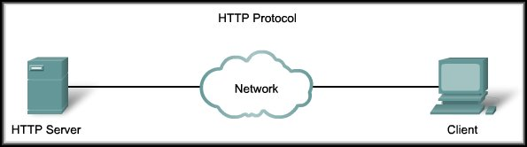
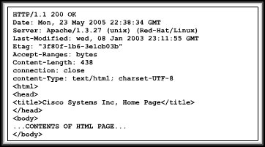
WWW Service and HTTP
Protocol
Browser
Web browsers are the client applications used to interpret the HTTP application protocol received from a web server.

Slide 49
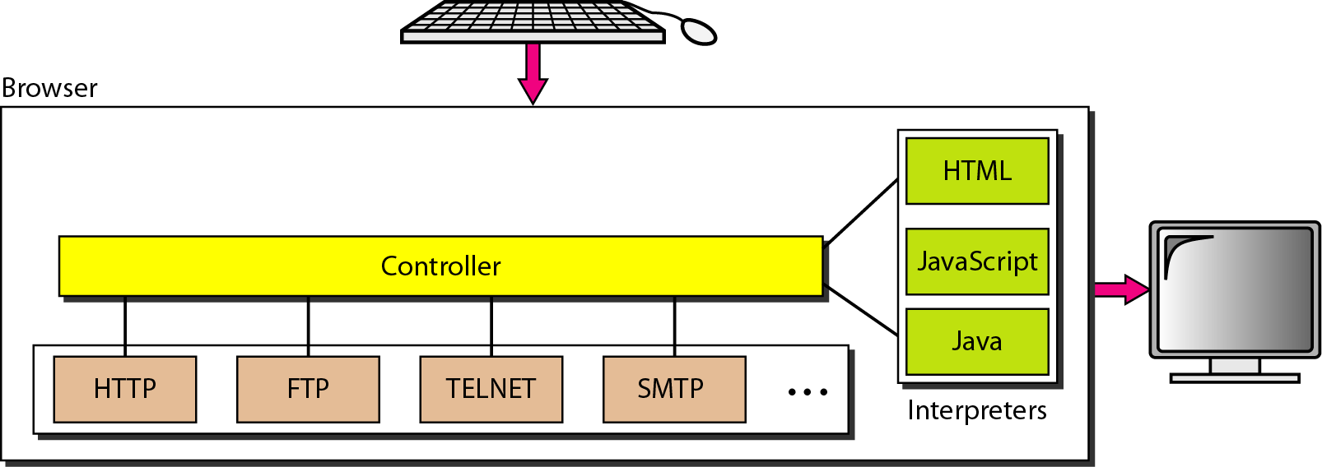
Web Browser

Slide 50

WWW Service and HTTP
Web Server:
  Stores the web objects (HTML, Pictures, Video, Files).
  Each accessible by a URL.
  Implements the server side of HTTP.
  Examples:
    Apache, Microsoft Internet Information Server (MIIS)

Slide 51
URL
The browser interprets the 3 parts of the URL:
1. http (the protocol or scheme)
2. www.cisco.com(the server name)
3. web-server.html (the specific file name requested).

Slide 52
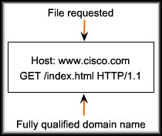

HTTP – How does it work?
DNS Reply
Get Request for Web page
Request
for IP address
Web Browser Displays
HTTP is a request/response type of protocol.
  HTTP 1.0: RFC 1945
  HTTP 1.1: RFC 2068

Slide 53
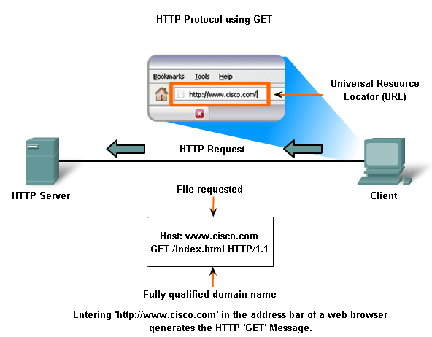
HTTP Request Message

Slide 54
Method/Message types
HTTP/1.0
GET
POST
HEAD
  asks server to leave requested object out of response
  debugging
HTTP/1.1
GET, POST, HEAD
PUT
  uploads file in entity body to path specified in URL field
DELETE
  deletes file specified in the URL field

Slide 55
WWW Service and HTTP
The server responds with either:
  The requested object.
  An error message, if necessary.
  Or other status messages.

Slide 56
HTTP Response Message
status line
(protocol
status code
status phrase)
HTTP/1.1 200 OK
Connection close
Date: Thu, 06 Aug 1998 12:00:15 GMT
Server: Apache/1.3.0 (Unix)
Last-Modified: Mon, 22 Jun 1998 …...
Content-Length: 6821
Content-Type: text/html
data data data data data ...
header
lines
data, e.g.,
requested
HTML file

Slide 57
HTTP response status codes
A few sample codes:
200 OK
  request succeeded, requested object later in this message
301 Moved Permanently
  requested object moved, new location specified later in this message (Location:)
400 Bad Request
  request message not understood by server
404 Not Found
  requested document not found on this server
505 HTTP Version Not Supported

Slide 58


WWW Service and HTTP
For secure communications, Secure HTTP (HTTPS) is used:
  Allows servers and clients to exchange information securely over the Internet.

